Slide 1
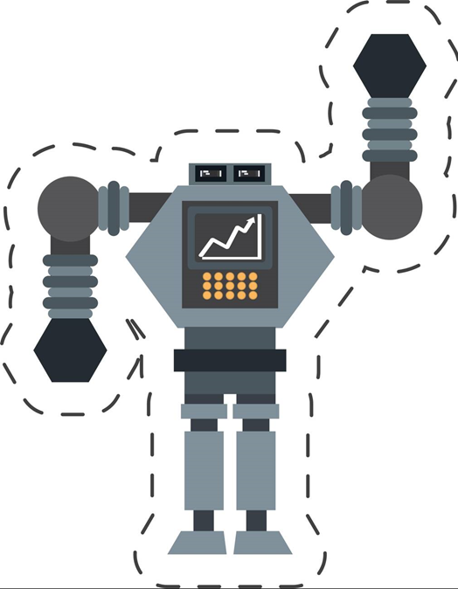

Autonomous Navigation System for Factory Floor Robots (AGVS) Team Members: • Pavitra A • ParomaDhara • Nivetha G K • PranakanthC • Neeraj Raghav V R • Niranjan S • Pranav Venkateswaran

Slide 2

Project Overview
This project presents a data-driven navigation system for Automated Guided Vehicles (AGVs) in factory environments.
By integrating real-time sensor data with machine learning algorithms, the system ensures safer movement around obstacles and humans, while optimizing path efficiency.

Slide 3
Problem Statement
AGVs in factories must navigate safely around humans and obstacles. Ultrasonic, IR, and PIR sensors detect proximity and motion. Sensor data is uploaded to the cloud where ML models drive navigation decisions. Data analytics identifies movement bottlenecks, high-traffic zones, and route efficiency. Visual tools support AGV traffic optimization and reduce collision risks, improving overall productivity and safety.
“Predictable motion is the key to autonomous safety”

Slide 4
Project Goal
Sensor Integration
Use Ultrasonic sensors, IR sensors, PIR sensors to detect obstacle distance and to detect human motion near AGVs.
Cloud Communication:
Transmit real-time sensor data from AGVs to the cloud using Wi-Fi (e.g., via Raspberry Pi Pico W).
Log and store data for historical analysis.
Machine Learning (XGBoost):
Train a predictive model using AGV activity data and predict for the next 7 days.
Power BI Dashboards:
Visualize real-time AGV alerts and sensor activity.
Show historical performance, collision risks, and predictive analytics.
Operational Optimization:
Identify and resolve movement bottlenecks.
Improve AGV routing based on predicted congestion.

Slide 5
Objectives
Develop a sensor-driven system to enhance AGV navigation and avoid collisions.
Enable real-time monitoring of AGVs through cloud-connected data streams.
Predict AGV traffic and congestion patterns using XGBoost Algorithm.
Use data analytics and visualizations to identify inefficiencies, collision risks, and high-traffic zones.
Create a modular, sensor-integrated system that can be scaled across multiple AGVs or factories.

Slide 6
Proposed Solution
Sensor-Driven AGV Navigation:
Use ultrasonic, IR, and PIR sensors to detect obstacles and motion
Continuously monitor proximity, movement, and environmental conditions
Real-Time Data Upload & Cloud Logging:
Push all sensor readings to the cloud via ThingSpeak
Export as time-series datasets for analysis and learning
Machine Learning-Based Decision Making:
Train an XGBoost classifier using labeled sensor data
Predict navigation actions: stop, slow and turn
Use synthetic + real data to improve model robustness

Slide 7
Proposed Solution
Time-Series Forecasting for Safety:
Forecast upcoming actions or risky patterns using future sensor readings
Enable proactive decisions before collisions occur
Visual Insights with Power BI:
Create dashboards to visualize:
High-risk zones
Hour-wise behavior patterns
Path efficiency and speed trends

Slide 8
Resources Utilized
Hardware: Raspberry Pi Pico W, Ultrasonic Sensor, Infrared Sensor, PIR Sensor
Software & Tools: Thonny IDE, ThingSpeak, Wokwi, MS Excel​
Datasets/ML Models Used:
- Source: ThingSpeak Cloud​
- Type: CSV file​
- Size: 976 KB (train)

Slide 9
Example Scenario
Assume there is an automobile industry like Tata motors.
A Tugger AGV is like a robotic train engine — often moving between warehouses, production lines, and storage zones.
Typical Working Areas:
Warehouse/Storage Zones
In-Plant Logistics Corridors
Assembly Lines
Return Loops
Example Tugger AGV Workflow in Automotive Plant
Job Assignment: The Tugger AGV is assigned to deliver seat components from storage to Line 2.
Navigation: Follows magnetic tape path or laser scan to reach Storage Zone A.
Coupling: Automatically hooks two loaded carts (with seats and armrests).
Transit: Moves through shared corridor with humans and forklifts, slowing near intersections.
Delivery: Stops precisely at Line 2, detaches carts, confirms via RFID scan.
Return: Heads to return bay or charging station.

Slide 10
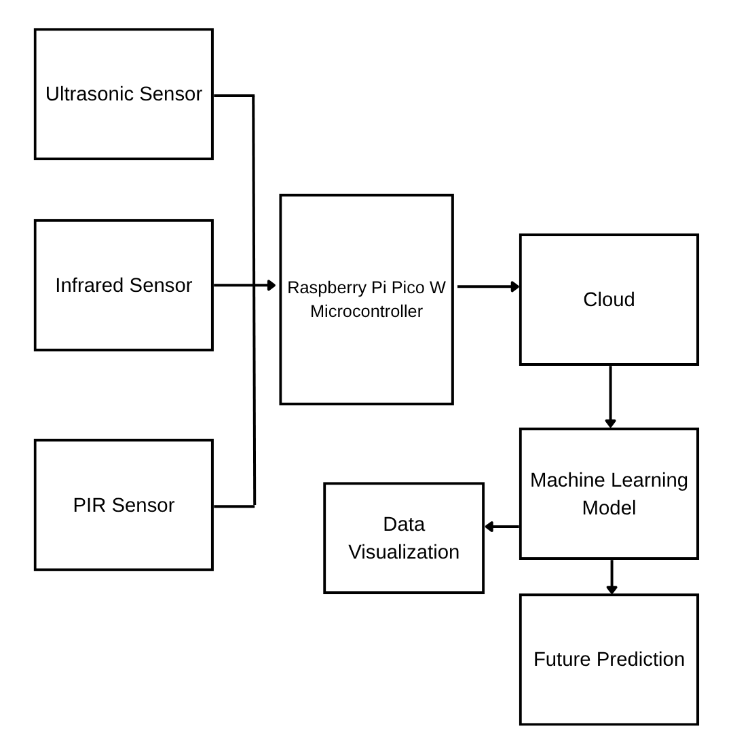
Block Diagram

Slide 11
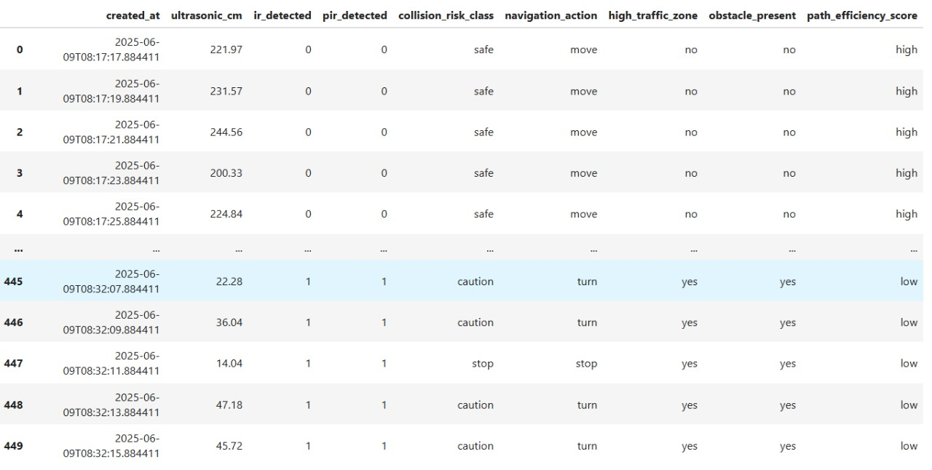
Dataset
Reference Dataset from Kaggle

Slide 12
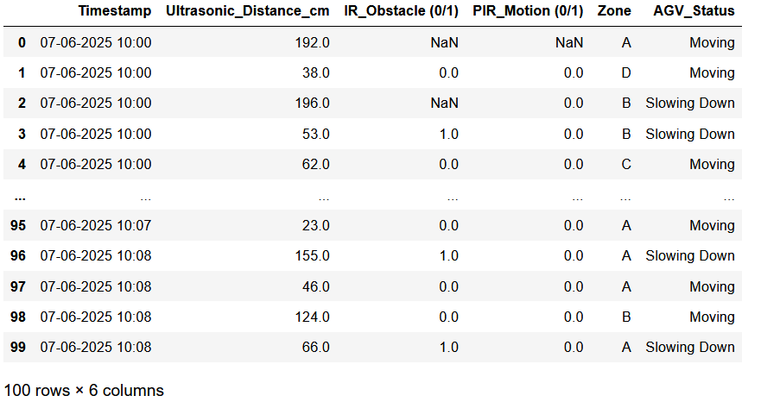
Dataset
Live Sensor Readings

Slide 13
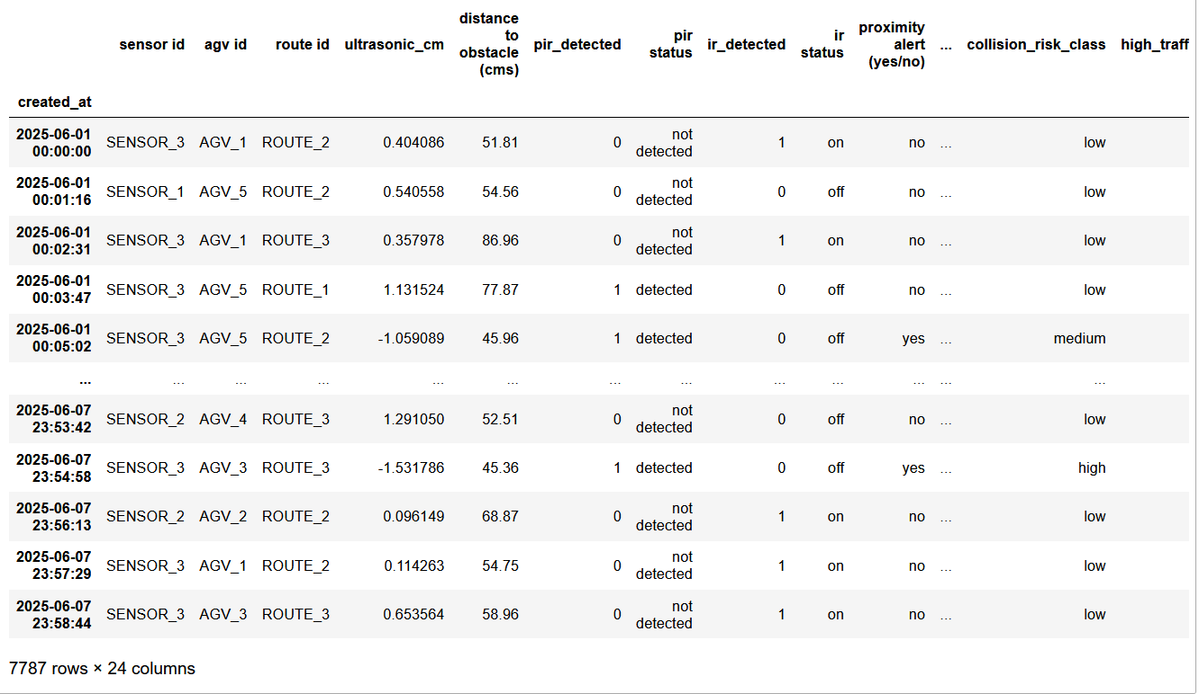
Dataset
Generated Train Dataset
Average interval: ~1.26 minutes
Features were generated using normal and uniform distributions.

Slide 14
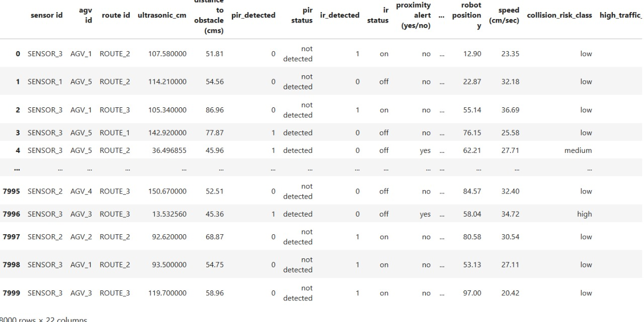
Dataset
Generated Future
Dataset

Slide 15
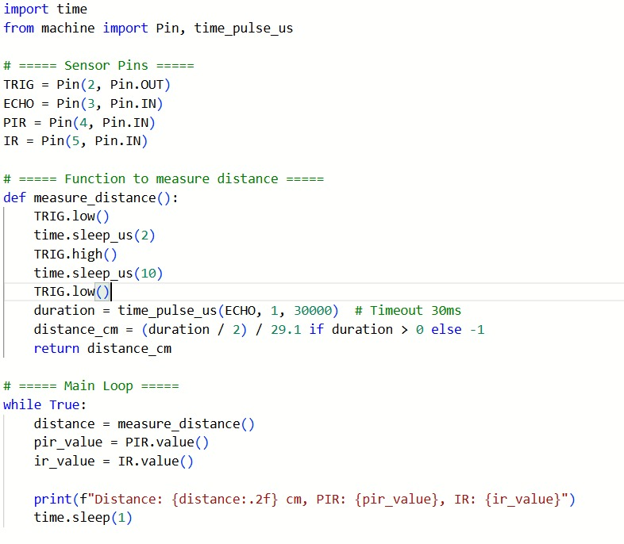
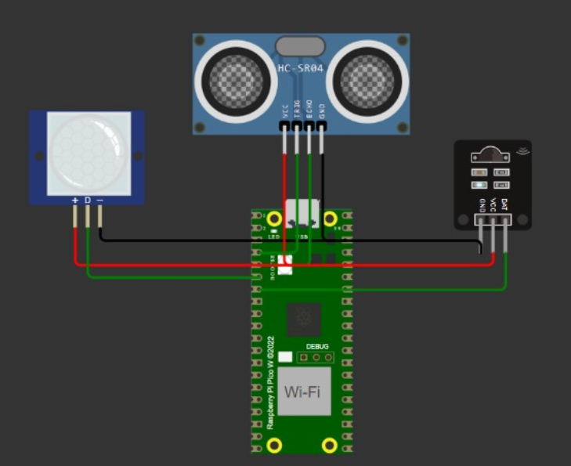
Wokwi Simulation
Version 1 – Without Buzzers/LEDs

Slide 16
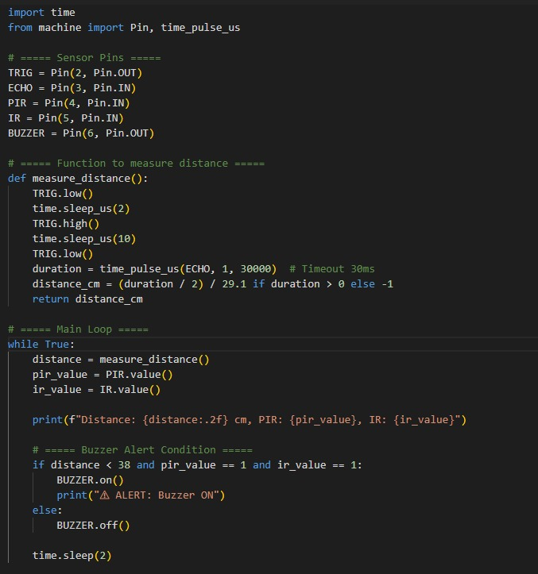
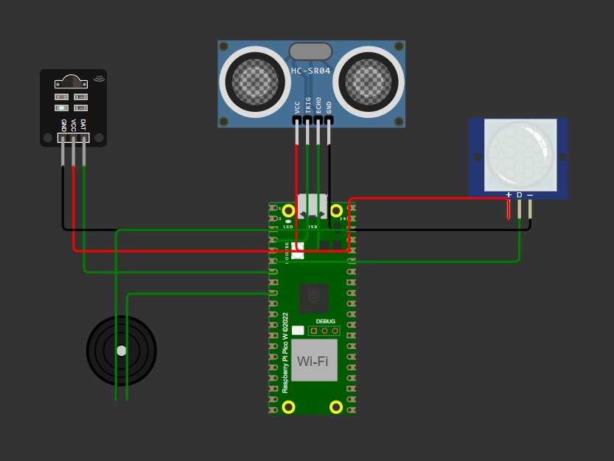
Wokwi Simulation
Version 2 – With Buzzers/LEDs

Slide 17
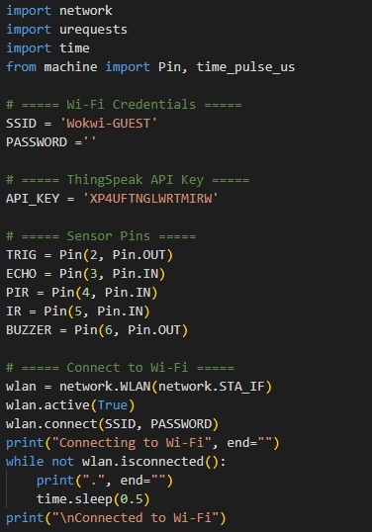
Wokwi Simulation
Version 3 – Cloud Connectivity

Slide 18
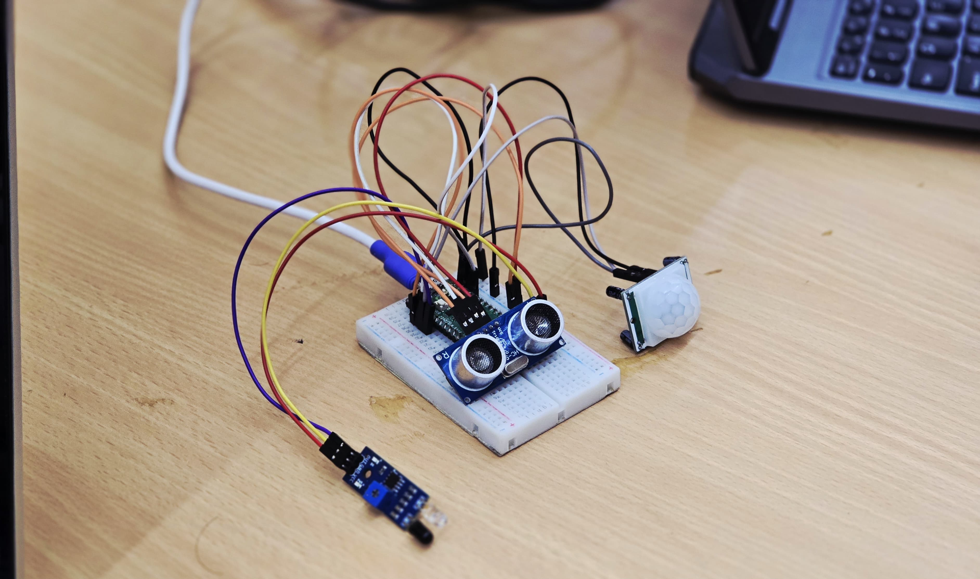
Hardware Implementation
Hardware and Micropython setup:
Raspberry Pi Pico W and sensors are configured
GPIO wiring
Thonny IDE
Wi-Fi and ThingSpeak Integration:
Credentials set up
Channel ID, API keys
Data Logging and Cloud export:
Real-time sensor data
Auto-updating graphs
Export the csv file

Slide 19
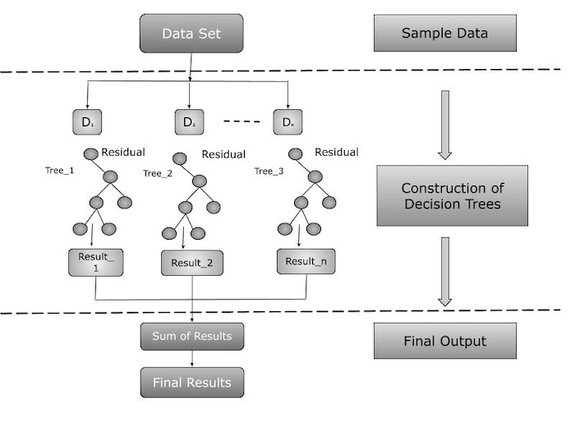
Machine Learning Model
XGBoost Algorithm
Why XGBoost ?
It handles both numerical and categorical features well.
It naturally copes with missing values.
It’s powerful for learning complex patterns in tabular data.
It performs well with balanced classification problems.
It’s highly efficient and scalable.

Slide 20
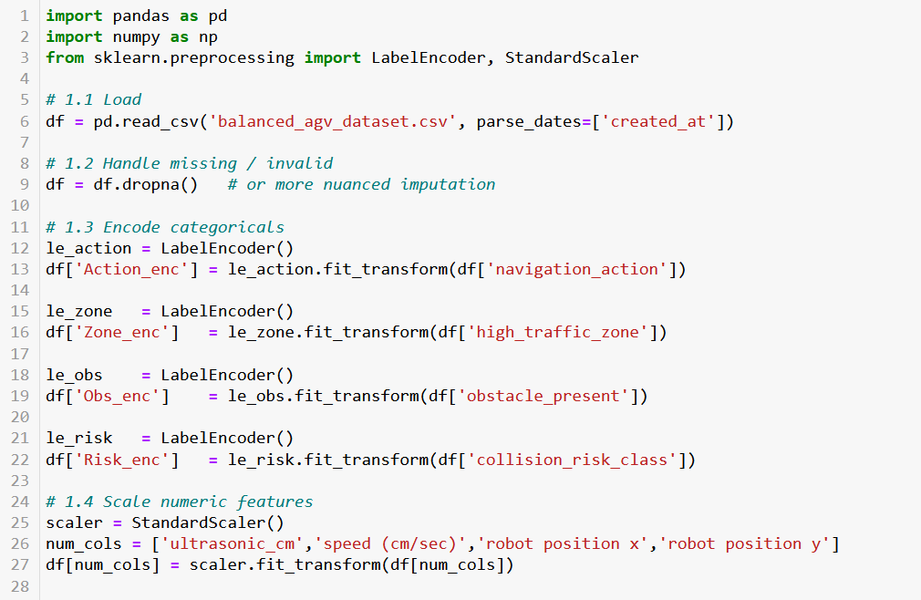
Machine Learning Model
Training phase
Preprocessing: Data Loading, Handling null values, Label Encoding of Categorical variables, Standardization of numerical features.
EDA
Model Training
Performance Metrics

Slide 21
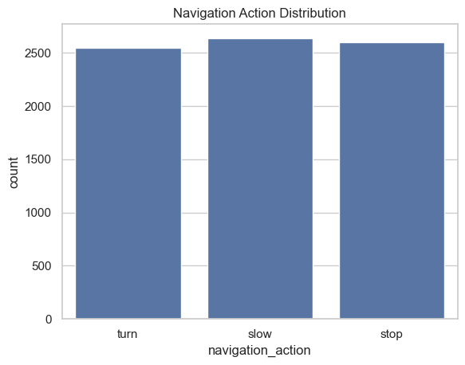
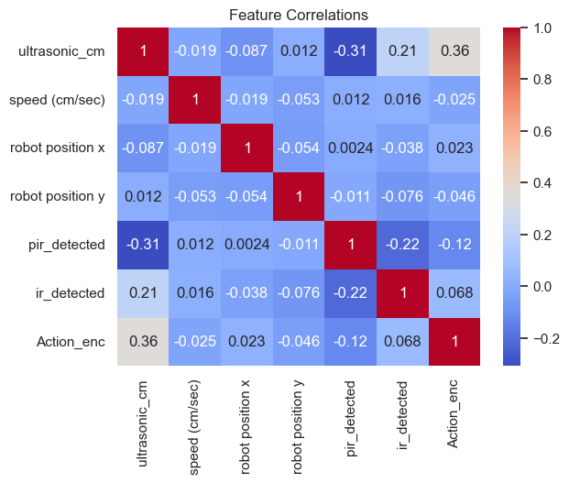
Exploratory Data Analysis
Target Class Distribution
Correlation Map

Slide 22
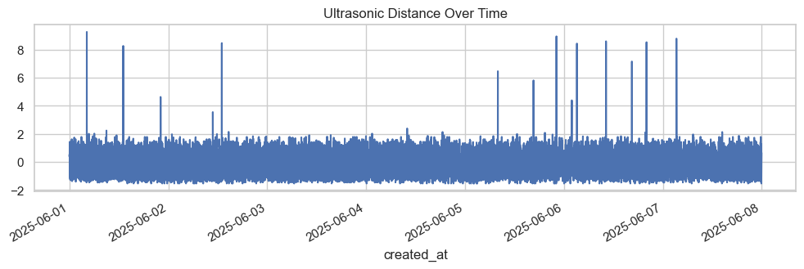
Exploratory Data Analysis
Time-series plot for Ultrasonic Distance vs Time

Slide 23
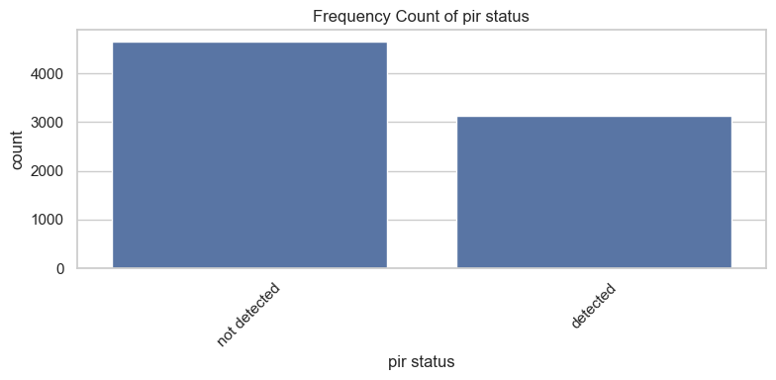
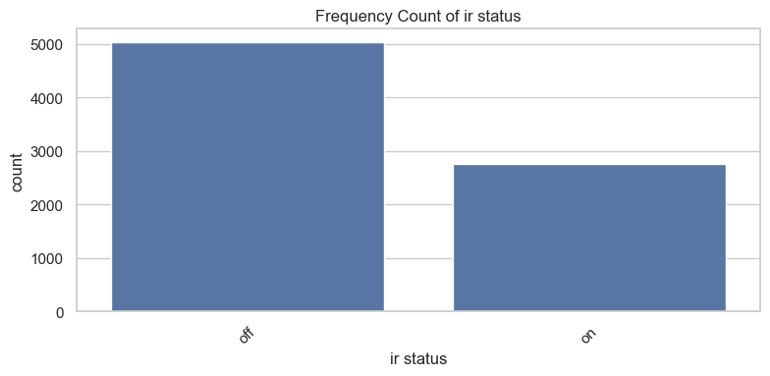
Exploratory Data Analysis
Target Class Distribution
Correlation Map

Slide 24
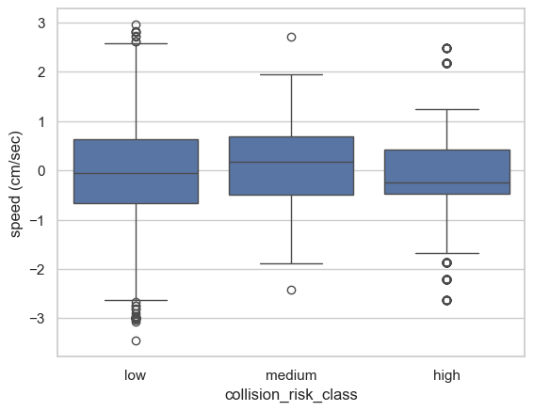
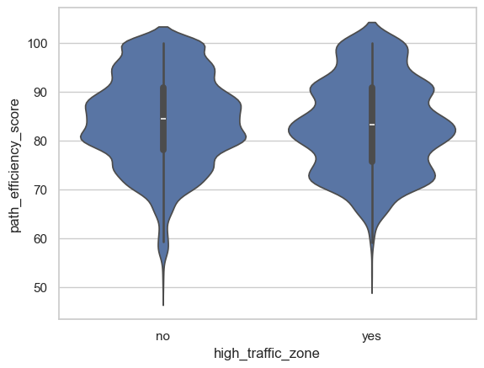
Exploratory Data Analysis
Collision Risk Class vs Speed
High Traffic Zone vs Path Efficiency Score

Slide 25
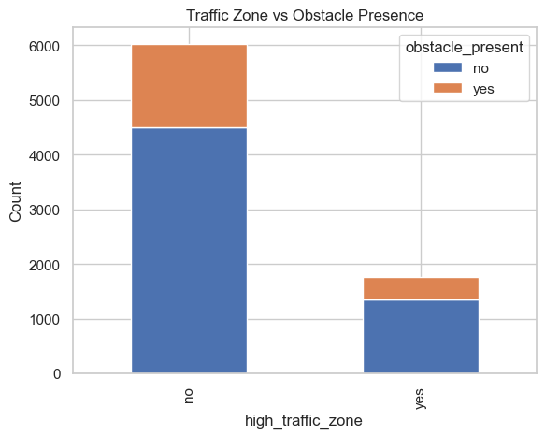
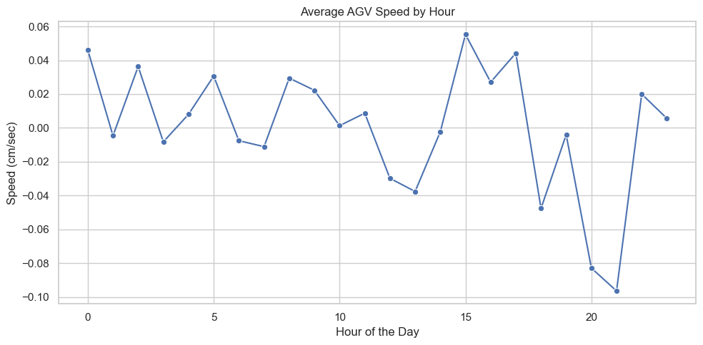
Exploratory Data Analysis
Traffic Zone vs Obstacle Presence
Speed variations over time

Slide 26
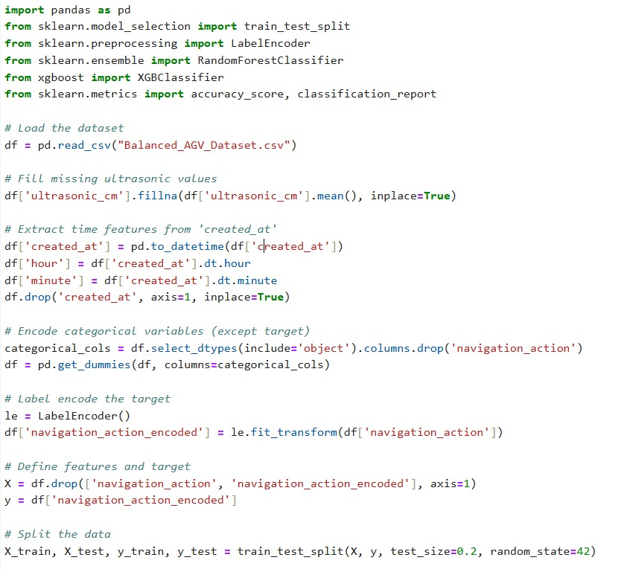
Future Data Forecasting
Testing Phase

Slide 27
Advantages & Limitations
Real-time detection of obstacles and humans minimizes collision risks.
Predictive analytics from sensor data improves route efficiency.
Easily extendable across new AGVs or factory locations.
Faulty or noisy sensor data may lead to incorrect navigation decisions.
Real-time operation is dependent on stable Wi-Fi; outages can disrupt performance.
Current system relies on proximity sensors, which may underperform outdoors.

Slide 28
Future Scope
Alternate path planning using GPS
Energy Optimization Algorithms
Real-time Voice Commands and Human-AI Interaction
Industrial 5G/LoRa Integration

Slide 29
Conclusion
The proposed AGV navigation system combines real-time sensor data, machine learning, and cloud connectivity to enhance factory automation, safety, and operational efficiency. The use of XGBoost enables predictive navigation decisions, reducing collisions and identifying high-traffic zones. With future enhancements like GPS integration and swarm-based routing, the system can evolve into a robust, industry-grade autonomous solution.

Slide 30
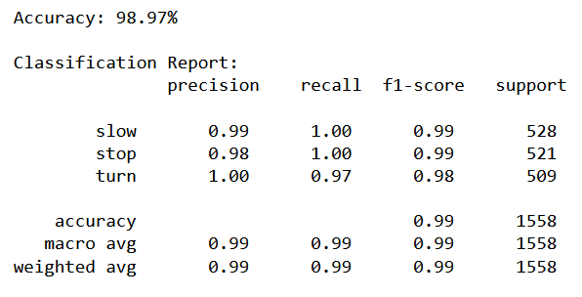
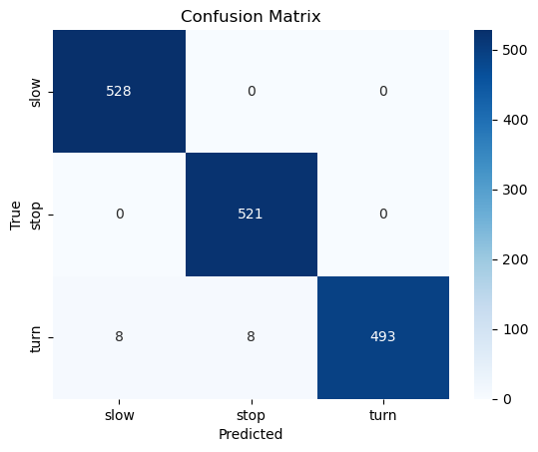
Results
Training Results
Confusion Matrix

Slide 31
Thank you

